Slide 1




Investing for Canada’s Food Future
April 29th, 2024

Slide 2

Land Acknowledgement
From coast to coast to coast, the SSFPA acknowledges the ancestral and unceded territory of the Inuit, Metis, and First Nations people that call this land home. We gratefully acknowledge Indigenous peoples as the original caretakers of the lands, waters, and foodways. We believe that our mutual interest in food sovereignty contributes to reconciliation, healing, and our decolonizing journey.
Venture-Capital Ready Program
2
Notes:
I’m a in Oakville, covered by Treaties 14 and 22, the territory of the Mississaugas of the Credit.
These lands have been home to the Anishinaabe, Attawandaron and Haudenosaunee

Slide 3
A little about me
Deloitte Consulting
Serial Entrepreneur
Approaching 10 years in Social Finance
Delivered multiple accelerators and programs
Working on 3 Impact Investing Funds
Manages the SVX US Investment Platform
Kevin Taylor
Associate Director
Venture-Capital Ready Program
3

Slide 4
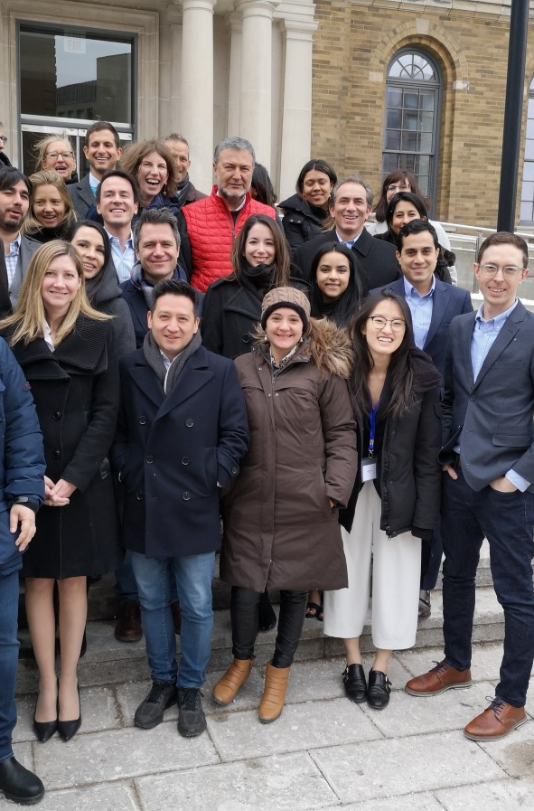

About SVX
KEVIN
SVX is a nonprofit, diversified financial services firm driving impact for investors, organizations, and funds.
We have designed, launched and supported multiple impact investment funds across Canada.
We lead multiple initiatives relating to Impact Investing including Catalyst Community Capital, Impact United, WIN VC, SVX Columbia.
SVX recently launched the Impact Index, a showcase of hundreds of Impact Investment opportunities across Canada and is registered as an Exempt Market Dealer (EMD).
We have partners and operations across Canada, as well as in the US, Columbia and Mexico.
4

Slide 5


Food Sovereignty vs Food Security
Setting the Stage
Food Sovereignty is about the food system in Canada and reshoring our capability to grow, process, and distribute food instead of relying on imports from multi-national Consumer Packaged Goods (CPG) companies.
Food security is ensuring everyone has access to the affordable food they need.
Strengthening Canada’s Food Sovereignty is a Critical Step of
Providing Food Security by Regaining Control of our Food Supply.
Notes:
Food security and food sovereignty are related concepts, but they have different focuses and implications:
Food Security:
Food security refers to the availability, access, and utilization of food that meets dietary needs and preferences for an active and healthy life.
It is often measured in terms of four dimensions: availability (the physical presence of food), access (the ability to obtain food), utilization (the proper use of food to meet nutritional needs), and stability (the consistency of food access over time).
Food security can be influenced by factors such as food production, distribution, purchasing power, food prices, trade policies, and social safety nets.
Achieving food security is a key goal for governments, international organizations, and humanitarian efforts, particularly in addressing hunger and malnutrition.
Food Sovereignty:
Food sovereignty goes beyond ensuring access to food and emphasizes the right of people to control their own food systems.
It encompasses principles of self-determination, democratic decision-making, and community empowerment in food production, distribution, and consumption.
Food sovereignty advocates for local and sustainable food systems that prioritize the needs and preferences of producers and consumers over the interests of corporate profit and global markets.
It recognizes the importance of cultural diversity, traditional knowledge, and ecological sustainability in food production and consumption.
Food sovereignty addresses issues of social justice, environmental sustainability, and economic equity within the food system, advocating for policies and practices that support small-scale farmers, indigenous peoples, and marginalized communities.
In summary, while food security focuses on ensuring access to an adequate and nutritious food supply, food sovereignty emphasizes the broader goals of empowerment, self-determination, and equity within the food system. While food security is often measured quantitatively, food sovereignty is more qualitatively focused on issues of governance, culture, and sustainability.

Slide 6





What’s included in the food ecosystem?
Setting the Stage
Ag-Tech
FARMING
PROCESSING
PACKAGING
DISTRIBUTION
RETAIL
Enteric Fermentation
Industrial Processes
Unsustainable Packaging Materials
Energy Inefficient Transportation Fleet
Energy Use in Stores
Synthetic Fertilizers
Energy Use
Manure Management
Waste Management
Resource Intensive Printing
Fragmented Supply Chains
Food Waste
Alternative Proteins
Farm Machinery
Refrigerants
Lack of Proper Disposal & Reuse

Slide 7
What’s included in the food ecosystem?
Setting the Stage
Ag-Tech
FARMING
PROCESSING
PACKAGING
DISTRIBUTION
RETAIL
Enteric Fermentation
Industrial Processes
Unsustainable Packaging Materials
Energy Inefficient Transportation Fleet
Energy Use in Stores
Synthetic Fertilizers
Energy Use
Manure Management
Waste Management
Resource Intensive Printing
Fragmented Supply Chains
Food Waste
Alternative Proteins
Farm Machinery
Refrigerants
Lack of Proper Disposal & Reuse

Slide 8
What’s included in the food ecosystem?
Setting the Stage
Ag-Tech
FARMING
PROCESSING
PACKAGING
DISTRIBUTION
RETAIL
Enteric Fermentation
Industrial Processes
Unsustainable Packaging Materials
Energy Inefficient Transportation Fleet
Energy Use in Stores
Synthetic Fertilizers
Energy Use
Manure Management
Waste Management
Resource Intensive Printing
Fragmented Supply Chains
Food Waste
Alternative Proteins
Farm Machinery
Refrigerants
Lack of Proper Disposal & Reuse

Slide 9

Canada’s Food Sovereignty Needs to be Rebuilt
Current Situation
Globalization and consolidation has greatly disrupted Canada’s food infrastructure (eliminating local processing, packaging and distribution) increasing our dependence on food imports despite being a major food producer.
Additionally, grocery oligopolies limit competitiveness for small businesses while favouring multinational brands based on unfair pricing and shelving practices.
COVID and other global crises have exacerbated these challenges, demonstrating the weaknesses in global supply chains.

Slide 10
Agenda
The Food System in Canada
Barriers and challenges we face
Reclaiming food sovereignty
How investment in food can help
Venture-Capital Ready Program

Slide 11
1
The Food System
in Canada
11

Slide 12

(Brief) History of the Food Sector in Canada
1. The Food System in Canada
Dependence on Britain
War Measures Act during WWII
1977 policies focus on growing production – NOT food insecurity or corporate concentration.
1998 and 2005 - Canada’s Action Plan for food Security (CAPFS) but nothing really came from it.
References: Food Policy for Canada – History, York University (adapted from MacRae and Abergel 2017)
Venture-Capital Ready Program
12
Notes:
Canada was initially limited in it’s ability to produce it’s own food to maintain dependence on Britain
Other than the War Measures Act during the WWII to avoid the food scarcity issues from WWI, no real policies were in place
In 1977 policies were put in place, but the focus was on growing production, and didn’t have specific regulations around food insecurity or corporate concentration.
Other attempts were made in 1998 and 2005 around Canada’s Action Plan for food Security (CAPFS) but nothing really came from it.

Slide 13

What leads to our wind down of local infrastructure?
1. The Food System in Canada
Economic Pressure
  Economies of scale made it hard to compete.
Consolidation
  Large corporates bought up small businesses or drove them out of business to increase their market share.
Globalization
  Free trade agreements introduced more competitors and enabled centralization of manufacturing facilities offshore.
Consumer Preference
  Consumers wanted consistent and convenient food.
Venture-Capital Ready Program
13
Notes:
Economists valuing comparative advantage lead to a few key partners exporting specific crops and other countries divesting from those activities

Slide 14
Food is a Major Contributor to Climate Change
1. The Food System in Canada
49.8
FOOD SYSTEM ACCOUNTS FOR
27%-33%
OF TOTAL GLOBAL EMISSIONS
Emissions Target:
22.4
&
60%
OF THE EMISSIONS
REDUCTION TARGET
13.6
Venture-Capital Ready Program
Source: Our World in Data
14
14
Note: Long-term emissions share of food systems was back-calculated using 2019 food system contribution of 27%
Notes:
The vast majority comes from livestock and crop.
Innovations in water, fertilizer and land use are trying to address these challenges alongside alternative proteins.
Growth in Ag tech and new models (alt protein, indoor / vertical farming, farm optimization, etc.)
Other contributions include waste in processing, transportation, packaging and retail channels. (18%)
ADDITIONAL POINT – Large corporations prioritizing profits may not factor in the impact of their suppliers – looking only at cost of inputs. Small businesses are more likely to be considerate of their suppliers when selecting them.

Slide 15
The Rise of Multi-National Food Processors
1. The Food System in Canada
These are public companies focused on maximizing shareholder value. Researches identified the following strategies used by leading brands:
  Reduce intense competition while maintaining dominance over smaller rivals;
  Raise barriers to market entry by new competitors;
  Use brand power and marketing to overshadow disruptive products
  Increase firm buyer power over suppliers;
  Increase firm seller power over retailers and distributors; and
  Leverage informational power asymmetries in relations with consumers.
References: Market strategies used by processed food manufacturers to increase and consolidate their power: a systematic review and document analysis, Globalizaion and Health, 2021
Revealed: The true extent of America’s food monopolies, and who pats the price, The Guardian, 2021
https://www.cbc.ca/news/business/price-discrimination-column-don-pittis-1.6799620
Venture-Capital Ready Program
15
Notes:
Consolidation has led to an increase in lobbying spend by food businesses to limit competition (6x increase since 1992)

Slide 16
Grocery Oligopolies Are Also Chasing Profits
1. The Food System in Canada
Grocers and Multinationals have been collaborating for a long time – the systems benefits them both.
  Slotting fees are required when new companies want to sell through grocery chains.
  Placement Fees allows larger companies to get premium shelf space (pricing out smaller players).
Large grocery chains also benefit from government programs (including food stamps in the US and gift card programs in Canada).
Farmers receive subsidies while grocery chains delivery record profits.
Venture-Capital Ready Program
16
Notes:
Canada has the highest market concentration of it’s 4 largest grocery chains than any other country (55% vs 39% for the US)
Government subsidies often focus on cash crops which are easy to export but strains fields.
Global News reported on Sunday that Minister Francois-Philippe Champagne is courting foreign grocers to enter the market, but a US chain told him it wasn’t possible to find leases for 400-500 locations to make the move feasible.

Slide 17
The current food system is harming Canadians
1. The Food System in Canada
More food is ultra-processed and less “real” than ever before
Ultra-processed food has been identified as a major health risk
  50% increase in cardiovascular disease-related death
  48-53% higher risk of anxiety
  12% greater risk of type 2 diabetes
14% of adults around the world are addicted to these types of foods
  “Ultra-processed foods are formulations of ingredients, mostly of exclusive industrial use, typically created by series of industrial techniques and processes (hence ‘ultra-processed’).”
References: Ultra-Processed food exposure and adverse health outcomes, The British Medical Journal, 2024
Venture-Capital Ready Program
17

Slide 18
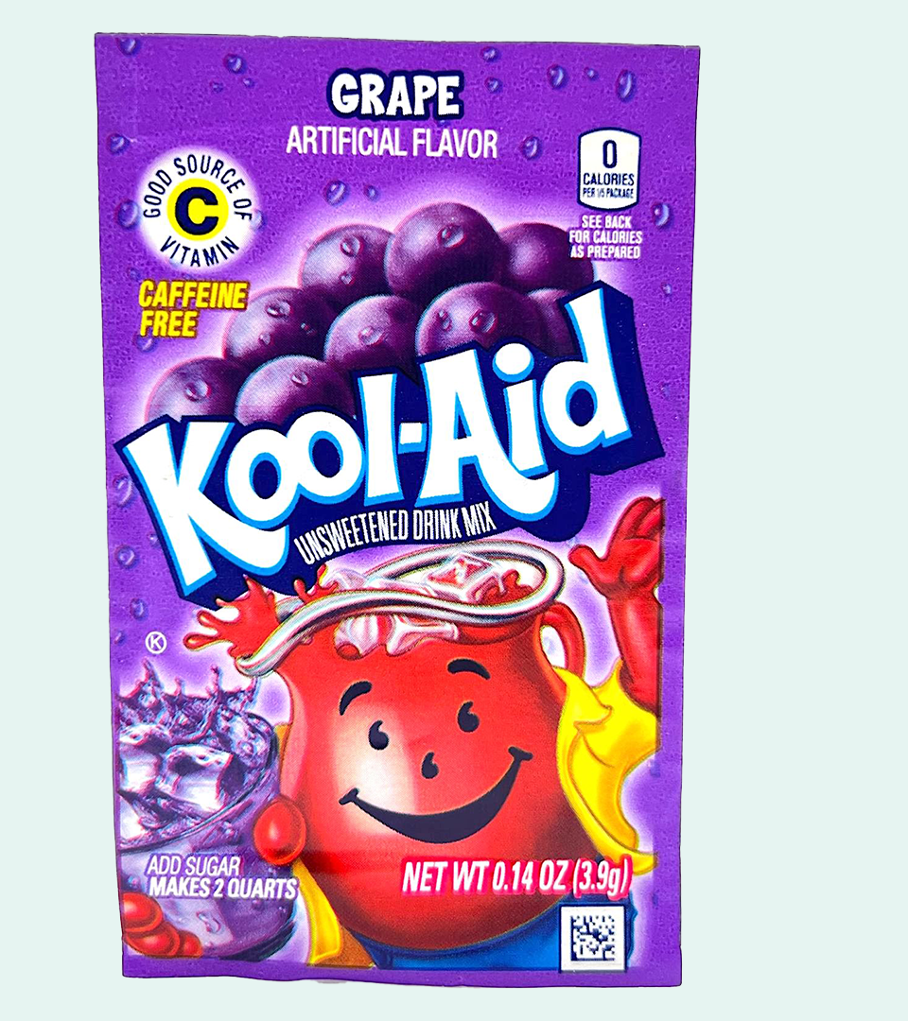
Risk of Unregulated Marketing
1. The Food System in Canada
Despite these health risks, products continue to be marketed and packaged in a way to downplay these health risks and are often promoted as healthy
Governments and non-profits are forced to combat this misleading marketing with an insignificant budget.
References: Food and beverage advertising expenditures in Canada in 2016 and 2019 across media, BMC Public Health, 2022
Venture-Capital Ready Program
18
Notes:
$628million was spent on marketing food products in Canada in 2019

Slide 19
Why do we need to rethink our food systems?
1. The Food System in Canada
Supply Chain Vulnerability
  COVID created massive supply issues as getting good in and out of the country was challenging
  War in Ukraine (soybeans and vegetable oil prices spiked)
Climate change
Traditional growing areas are seeing increase volatility in weather systems resulting in less predictable growth
Changing Demographic
Gen Z and Millennials are less brand loyal and more sustainability minded driving a different mindset on food consumption
References: https://abcnews.go.com/International/1-year-war-ukraine-affecting-food-supplies-prices/story?id=97320422
Food Distribution Guy, Nov 2023, Richard Baker
Venture-Capital Ready Program
19
Notes:
Vulnerability in the supply chain
COVID created massive supply issues as getting good in and out of the country was challenging
War in Ukraine (soybeans and vegetable oil prices spiked)
Growing population is going to significantly increase the need for food in Canada
Millenial and Gen Z – less brand loyal, more sustainable minded, struggling with housing affordability.
Decrease in value generated here (high pressure on commodity pricing keeps money out of the hands of small farmers, most added value in processing is done outside of Canada, food is more packaged, processed and devoid of health benefits to increase shelf stability).

Slide 20
2
Barriers and
Challenges
20

Slide 21

Policy Environment Favours Massive Companies
2. Barriers and Challenges
Large CPG companies invest significantly in lobbying
  Overly restrictive regulations can be prohibitive for smaller businesses (requiring massive investment to meet the requirements)
  Governments tend to Focus on larger multinationals with financial support despite the fact that SMEs provide 90% of Canada’s private sector employment.
  Restrictive leases allow major grocers to dictate who else can lease space in the plaza they are in.
References:Why does Canada’s industrial policy favour Big Business over Main Street?, globe and Mail, 2024
Venture-Capital Ready Program
21
Notes:
Lobbying spend is at $175M during the 2020 election campaign in the US
Focus on GDP, Tarifs and Taxes vs long term sustainability
This was often drive by an outdate economic theory that assumes 1 new job at a large enterprise creates 5 new local, less skill driven jobs. But when those corporations are importing most of their goods, that multiplier effect is not happening locally.
Large CPG companies invest significantly in lobbying
Regulations can be prohibitive for smaller businesses (requiring massive investment to meet the requirements)
Governments tend to support larger “too big to fail” businesses because they see the impact as being larger based on the effort (write 3-5 big cheques)
Trying to understand and provide similar supports to SME’s is daunting, despite the fact that SMEs provide 90% of Canada’s private sector employment.
This was often drive by an outdate economic theory that assumes 1 new job at a large enterprise creates 5 new local, less skill driven jobs. But when those corporations are importing most of their goods, that multiplier effect is not happening here.
Small businesses are actually more likely to buy local and create that multiplier effect.

Slide 22
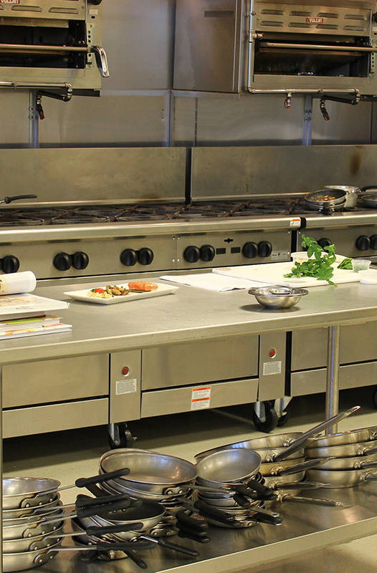
The “Missing Middle” limits the growth of food businesses
2. Barriers and Challenges
Lack of regional infrastructure (The “Missing middle”) has made it challenging to scale regional food businesses.
  Co-packing / Shared processing
  Packaging / Canning
  Local Distribution
  New Retail Models
  Lack of Comprehensive Data
Venture-Capital Ready Program
22
Notes:
Don’t know how many food businesses are actually out there
Don’t really know where local food is consumed

Slide 23
Raising Capital For Food Businesses is Difficult
2. Barriers and Challenges
There is a lack of access to finance and growth capital
  Demographic challenges (immigrant and women lead business)
  Don’t fit the traditional Venture Capital mold
  Requires new and innovative financing approaches (revenue share loans, shared equity approach, etc.)
Investor Interest is low / indifferent
  Investor’s lack familiarity in the food sector making them less likely to invest
  Limited time / ability to find, review, and assess potential investments
Venture-Capital Ready Program
23

Slide 24

Investments in food are seen as risky
2. Barriers and Challenges
Public markets are no longer grounded in business value, and instead reflect speculation based on investor interest.
  Beyond Meat went from a $25 IPO price to $169 / share before dropping to $6.
Misconception about investing meaningfully (i.e., sustainable, local, impact investing) delivering lower returns
  Despite strong performance from impact focus investment funds, most investors still perceive them as lower returns
References: Misconceptions about costs discourage sustainable investing, The Co-operators, 2023
Venture-Capital Ready Program
24
Notes:
Public markets are no longer grounded in business value, and instead reflect speculation based on investor interest.
Beyond Meat went from a $25 IPO price to $169 / share before dropping to $6. Although not at the same level of MEME stock as Gamestop or AMC, this was influenced by market interest in owning the stock vs. actual analysis of the business opportunity.
Misconception about investing meaningfully (i.e., sustainable, local, impact investing) delivering lower returns
Despite strong performance from impact focus investment funds, most investors still perceive them as lower returns

Slide 25
Economic environment creates uncertainty
2. Barriers and Challenges
High interest rates and high inflation has hit consumers budgets
  Local food is available, but often at a slight premium
  Small processors don’t have the same economies of scale to be price competitive with major companies.
  Lack of shared infrastructure, accessible distribution, food storage facilities and bargaining power
When push comes to shove, we can’t rely on consumer choice, when the choice is between enough food on the table for everyone, or good, healthy, local food on the table for some.
Venture-Capital Ready Program
25

Slide 26
Political polarization has made compromise difficult
May delete
2. Barriers and Challenges
Political polarization globally is fracturing communities
  One side is pushing for a focus on immediately lowering costs and creating jobs
  The other is looking long term to build a sustainable future with lower costs and more jobs.
Media consumption has lead to people responding better to attack adds around our fears.
  This approach is creating an “us” or “them” mentality within communities based, often based around wealth.
Venture-Capital Ready Program
26
Notes:
Political polarization globally is fracturing communities and leaning towards black or white understanding of issues instead of recognizing the inter connectivity of issues being pushed by both sides of the aisle
One side is pushing for a focus on low costs, profit oriented thinking recognizing the poor financial standing of many Canadians and leaning heavily into capitalistic mindset that if the economu is doing well, there will be good paying jobs and Canadians will benefit
The other is looking long term with a focus on innovation within sustainability to endure current hardships to ensure the long term viability of communities and the environment.
Media consumption has lead to people responding better to attack adds around our fears (job security, environmental risk, maintaining existing bias, reactive over correction around systemic bias).
This approach is creating an “us” or “them” mentality within communities based, often based around wealth.

Slide 27
3
Reclaiming Food Sovereignty
27

Slide 28
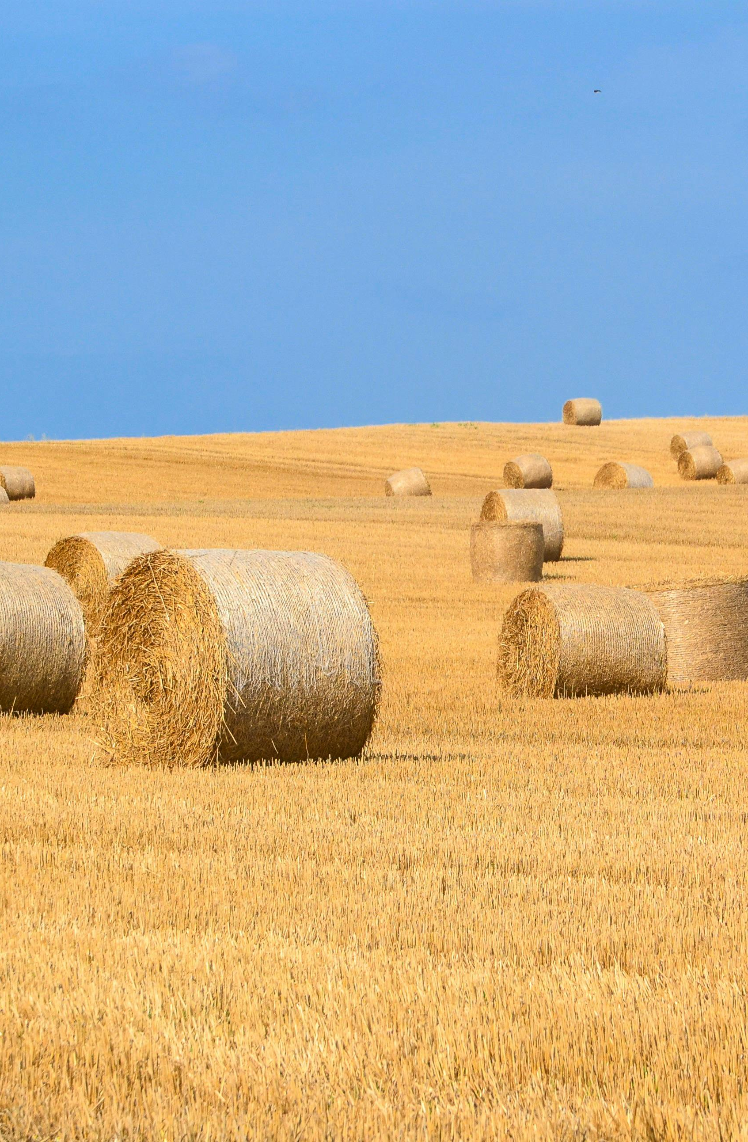
How do we reclaim our food sovereignty?
3. Reclaiming Food Sovereignty
Support small scale farmers.
Invest in local food infrastructure.
Provide accessible and appropriate forms of capital.
Increase collaboration across organizations in the food sector.
Advocate for policy reforms to strengthen local food systems.
Rethink how we eat!
Venture-Capital Ready Program
28

Slide 29
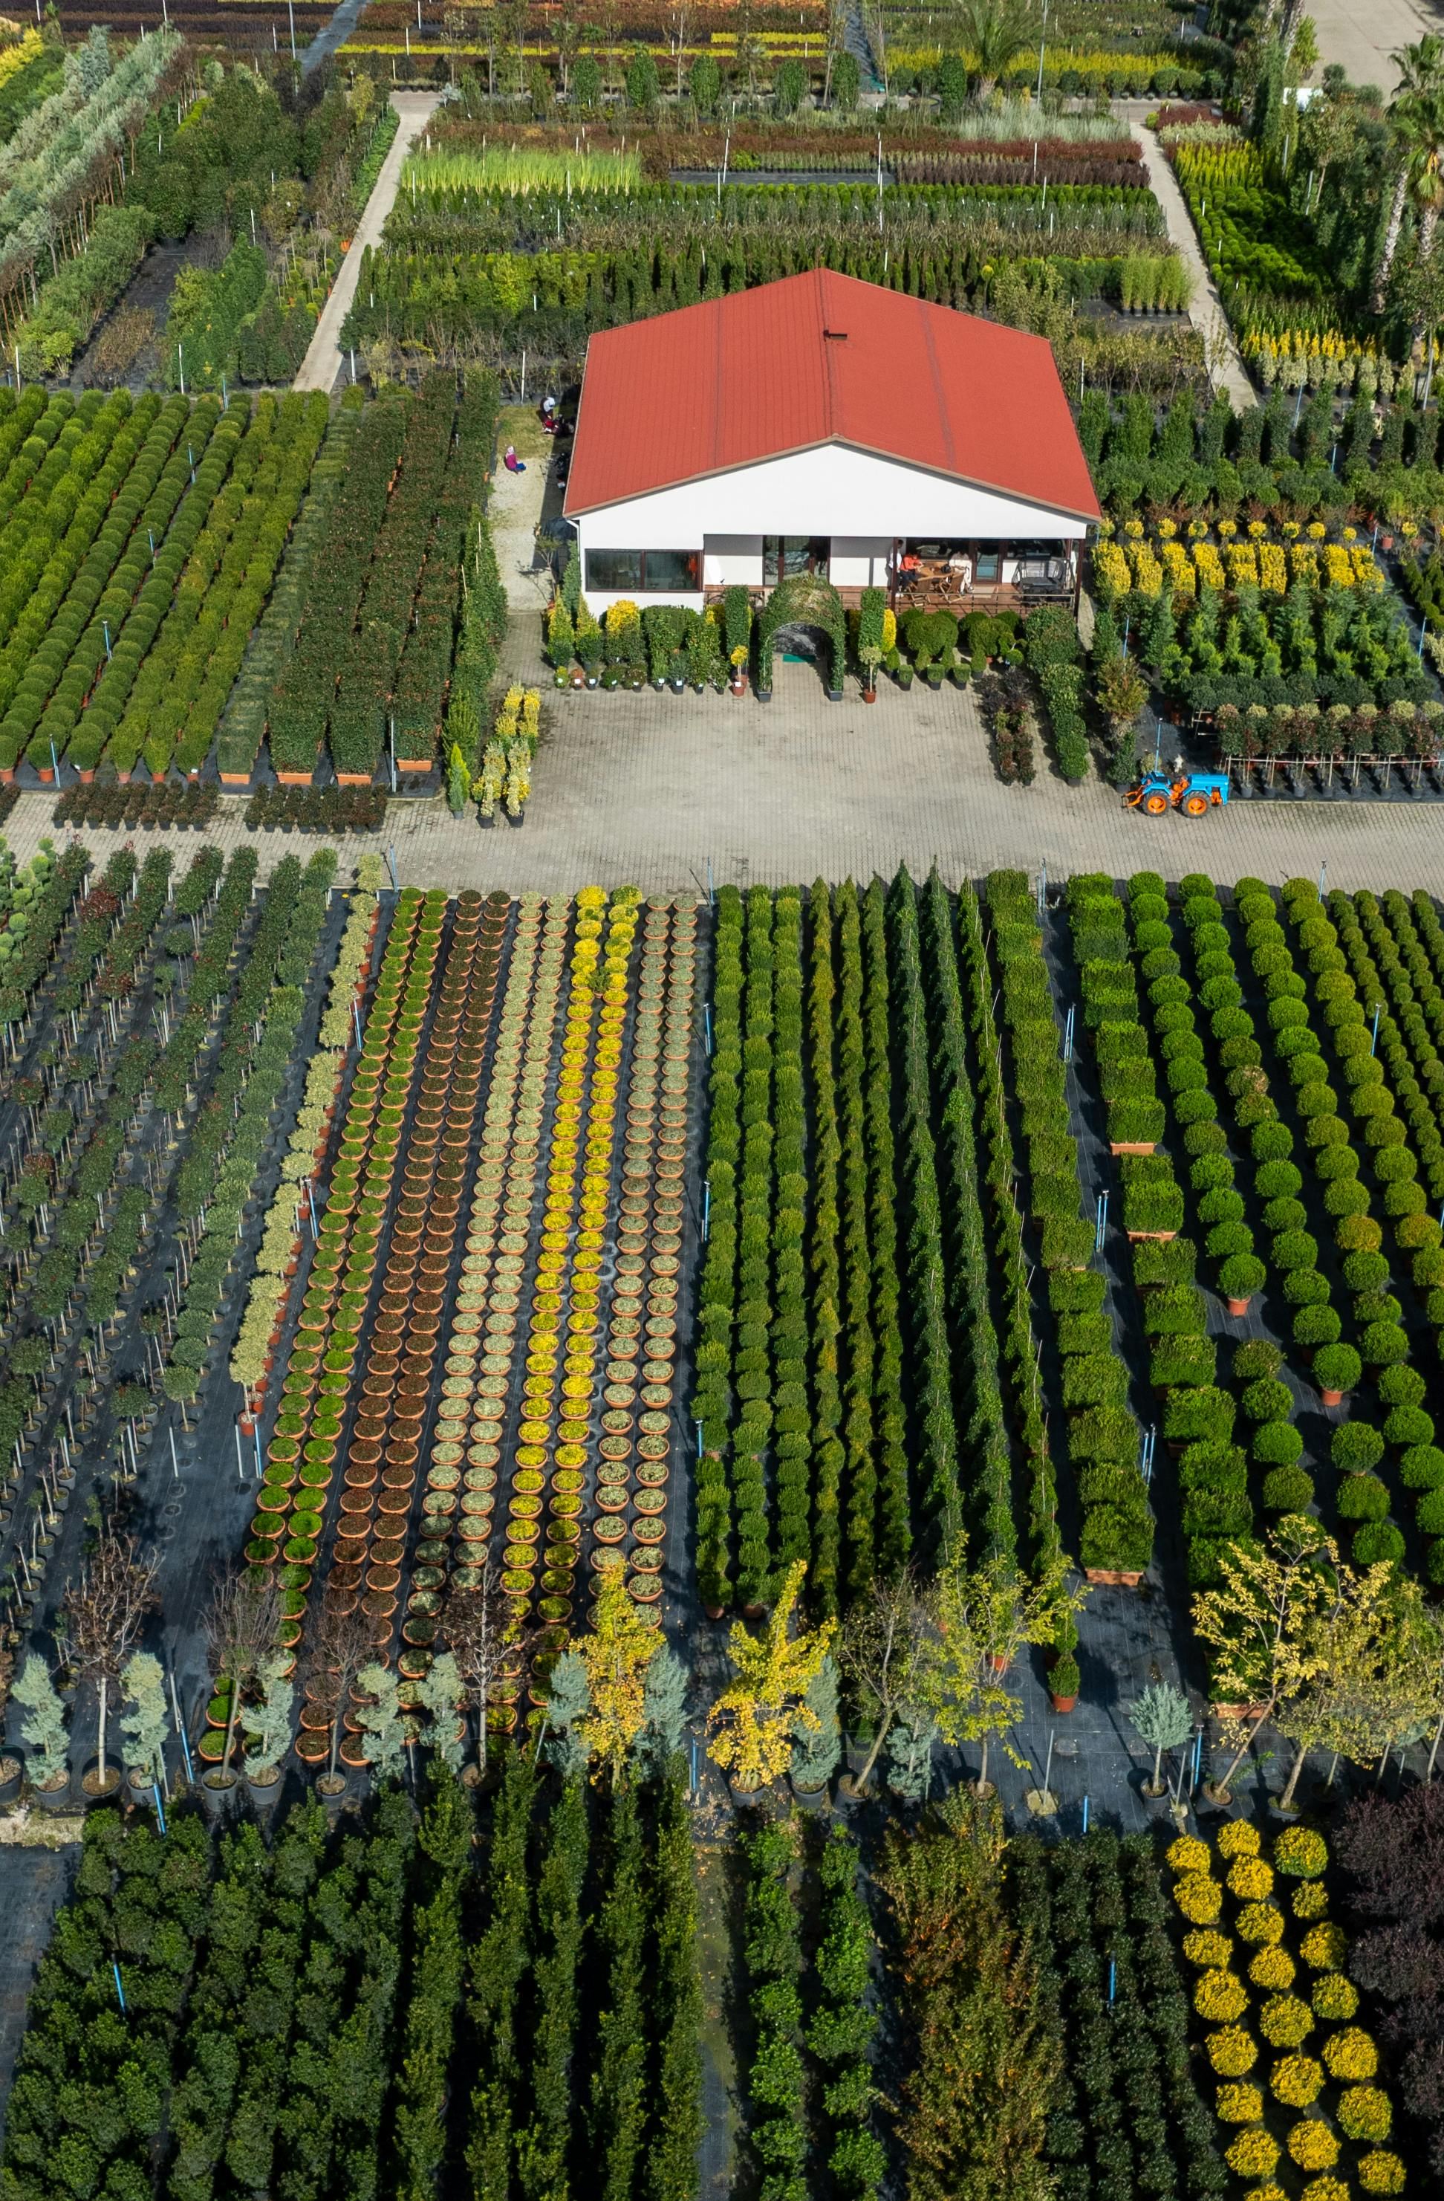
1. Support small scale farmers
3. Reclaiming Food Sovereignty
Implement policies and programs that support small-scale and family-owned farms, including access to land, credit, technical assistance, and marketing support.
Encourage diversified farming practices, agroecology, and regenerative agriculture to enhance resilience and sustainability.
Support initiatives that promote crop rotation, agroforestry, and intercropping to improve soil health, biodiversity, and resilience to pests and diseases.
This could also include more regulations and controls around commercial farms to hold them to the standard of quality and sustainability.
Venture-Capital Ready Program
29

Slide 30

2. Invest in local food infrastructure
3. Reclaiming Food Sovereignty
Food Hubs
  Fraser Valley
  County Food Hub
  Neighbourhood Food Hub Initiative
Distribution
  FreshSpoke
  Co-op and non profit lead community distributors
Canning and Packaging
Procurement / Market Making
  Grain Discovery
Venture-Capital Ready Program
30

Slide 31
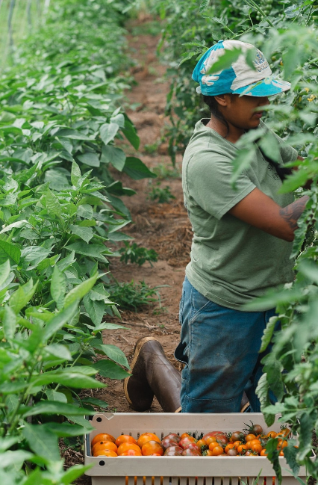
3. Provide accessible and appropriate forms of capital.
3. Reclaiming Food Sovereignty
Investment Funds
  FarmWorks Investment Co-op
  Fair Finance Fund
  *Bloom Local Food Fund
  The51 Food and Agtech Fund
  *In development - SSFPA national fund
  District Ventures / VenturePark
  Raven Indigenous Capital Partners
* SVX is a co-owner, service provider or direct partners of these funds
Venture-Capital Ready Program
31

Slide 32
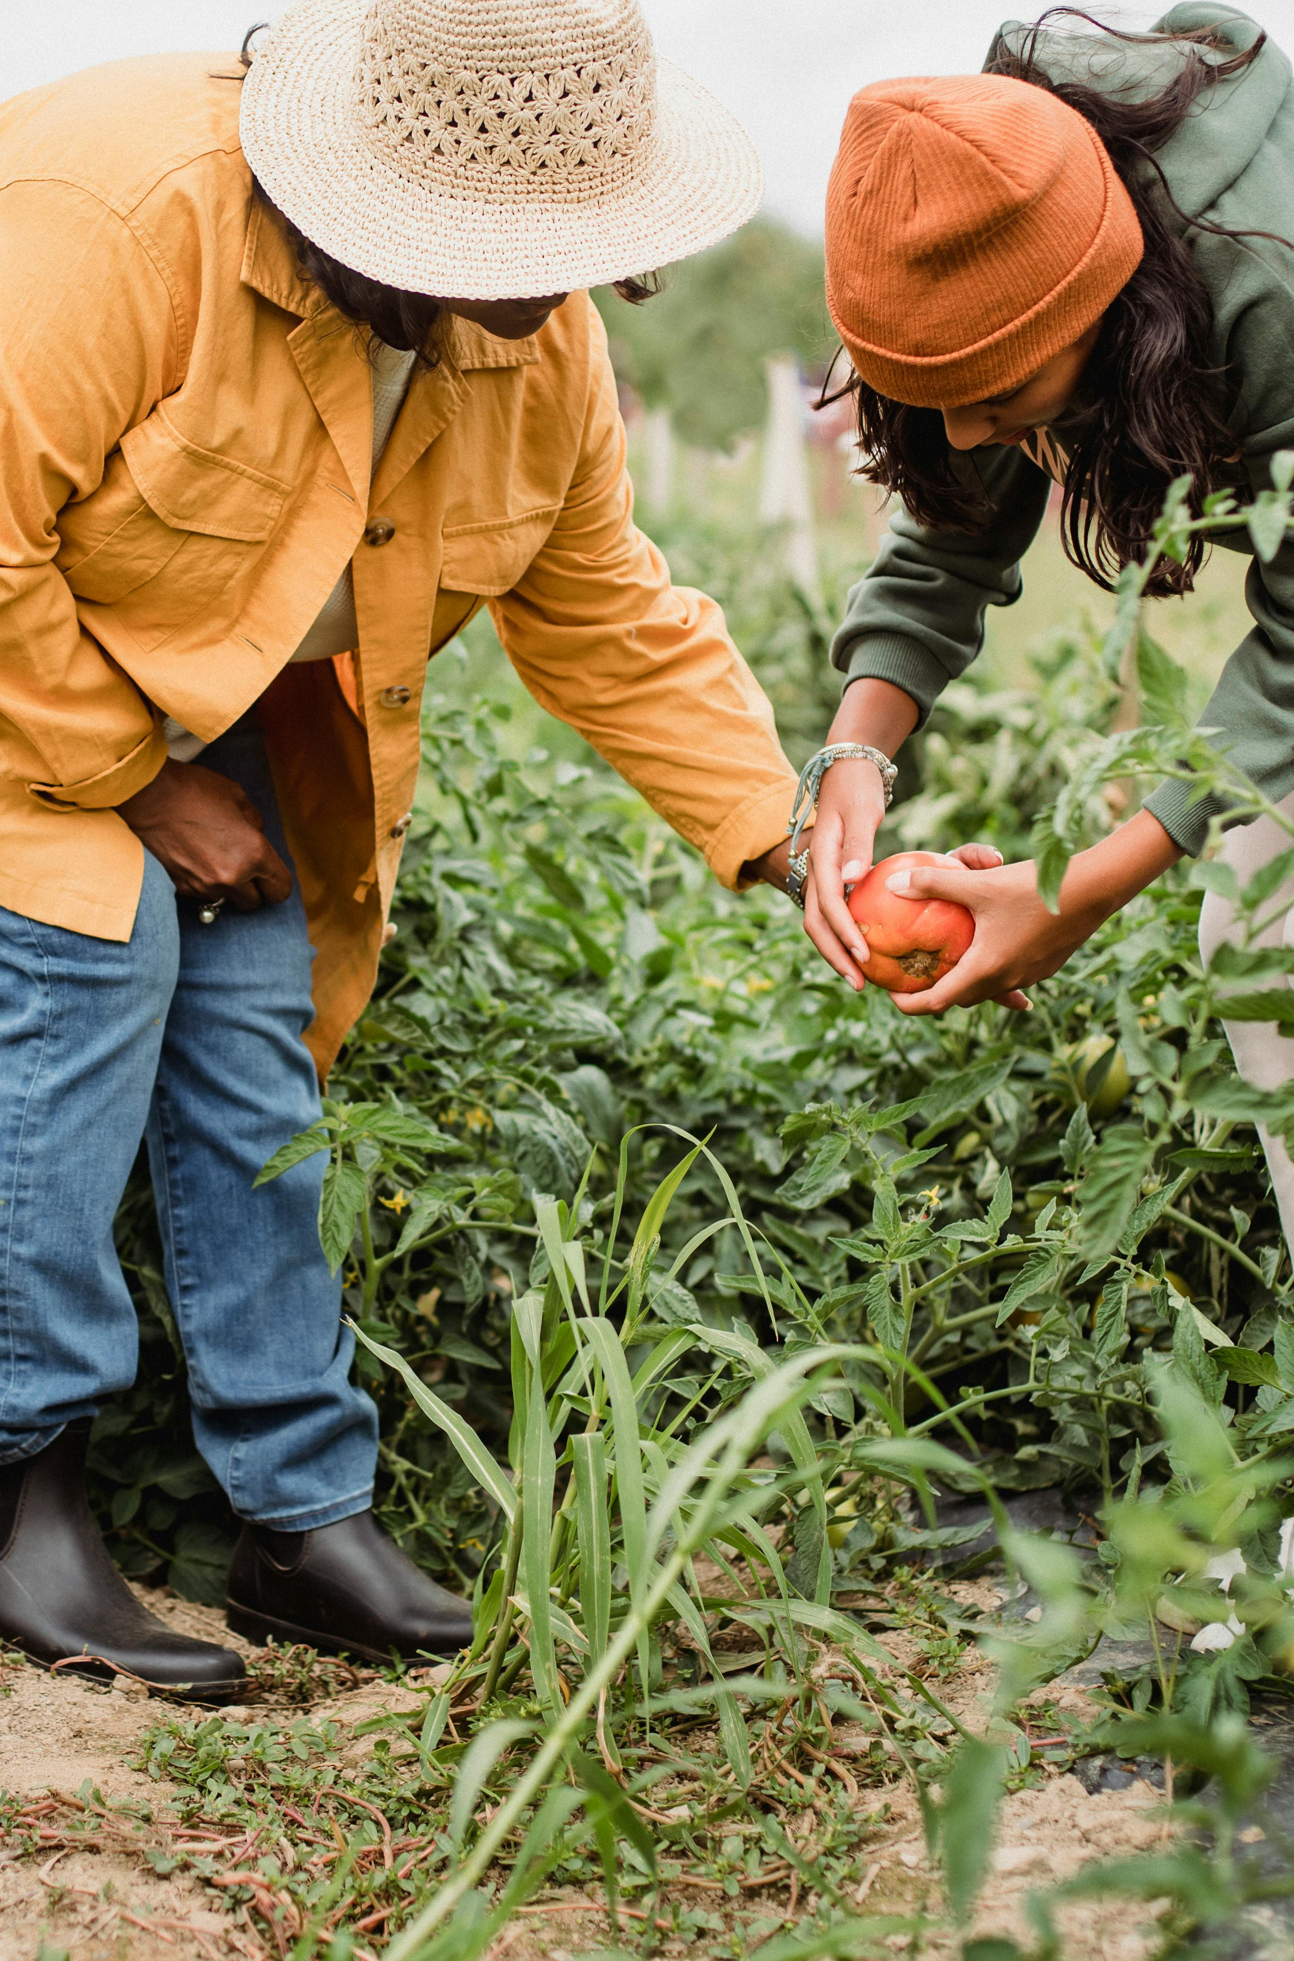
4. Increase collaboration across food organizations.
3. Reclaiming Food Sovereignty
There are so many amazing organizations keyed into this – we need to continue to strengthen how we work together.
  Small Scale Food Processors Association (SSFPA)
  PARO Centre
  Spring
  Movement51
  SVX
  Just Food Ottawa
  Canadian Food Innovation Network (CFIN)
  Canadian Agri-Food Policy Institute (CAPI)
  Collectif Récolte
  Transformation Investing in Food Systems (TFIN)
Venture-Capital Ready Program
32

Slide 33
5. Advocate for policy reforms to create a level playing field.
3. Reclaiming Food Sovereignty
Create pools of capital to build and de-risk infrastructure projects.
Develop meaningful regulations that don’t unnecessarily exclude new entrants
Create legislation to combat anticompetitive behavior for major brands.
Mandate or incentivize local food supply through major grocery chains.
Develop tax frameworks to de-risk investment into the food sector.
Track and monitor the true economic impact of small scale food processors, the restoration of the missing middle, and the reshoring of the Canadian food ecosystem.
Venture-Capital Ready Program
33
Notes:
Create pools of capital to build and de-risk infrastructure projects to enable local food systems.
Review meaningful regulations that protect Canadians without limiting competition.
Create legislation to combat anticompetitive behavior for multinational producers, processors and grocers.
Mandate or incentivize local food supply through major grocery chains.
Develop tax frameworks to de-risk investment into the food sector (and other impactful sectors) to allow Canadians to use their savings for good.
Track and monitor the true economic impact of small scale food processors, the restoration of the missing middle, and the reshoring of the Canadian food ecosystem.

Slide 34
6. Rethinking how we eat
3. Reclaiming Food Sovereignty
Buy local – and don’t expect year-round access to fruits that need to be shipped from overseas.
Look for locally farmed produce and promote Vertical farming businesses that have a lower carbon footprint and reduce the food miles in your home.
Pay attention the nutrition of the food we eat and focus on quality vs cost alone
Look outside of national grocery chains and be more mindful of the price you're paying.
Venture-Capital Ready Program
34

Slide 35
4
How Investment in Food can Help
35

Slide 36
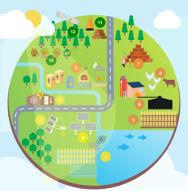
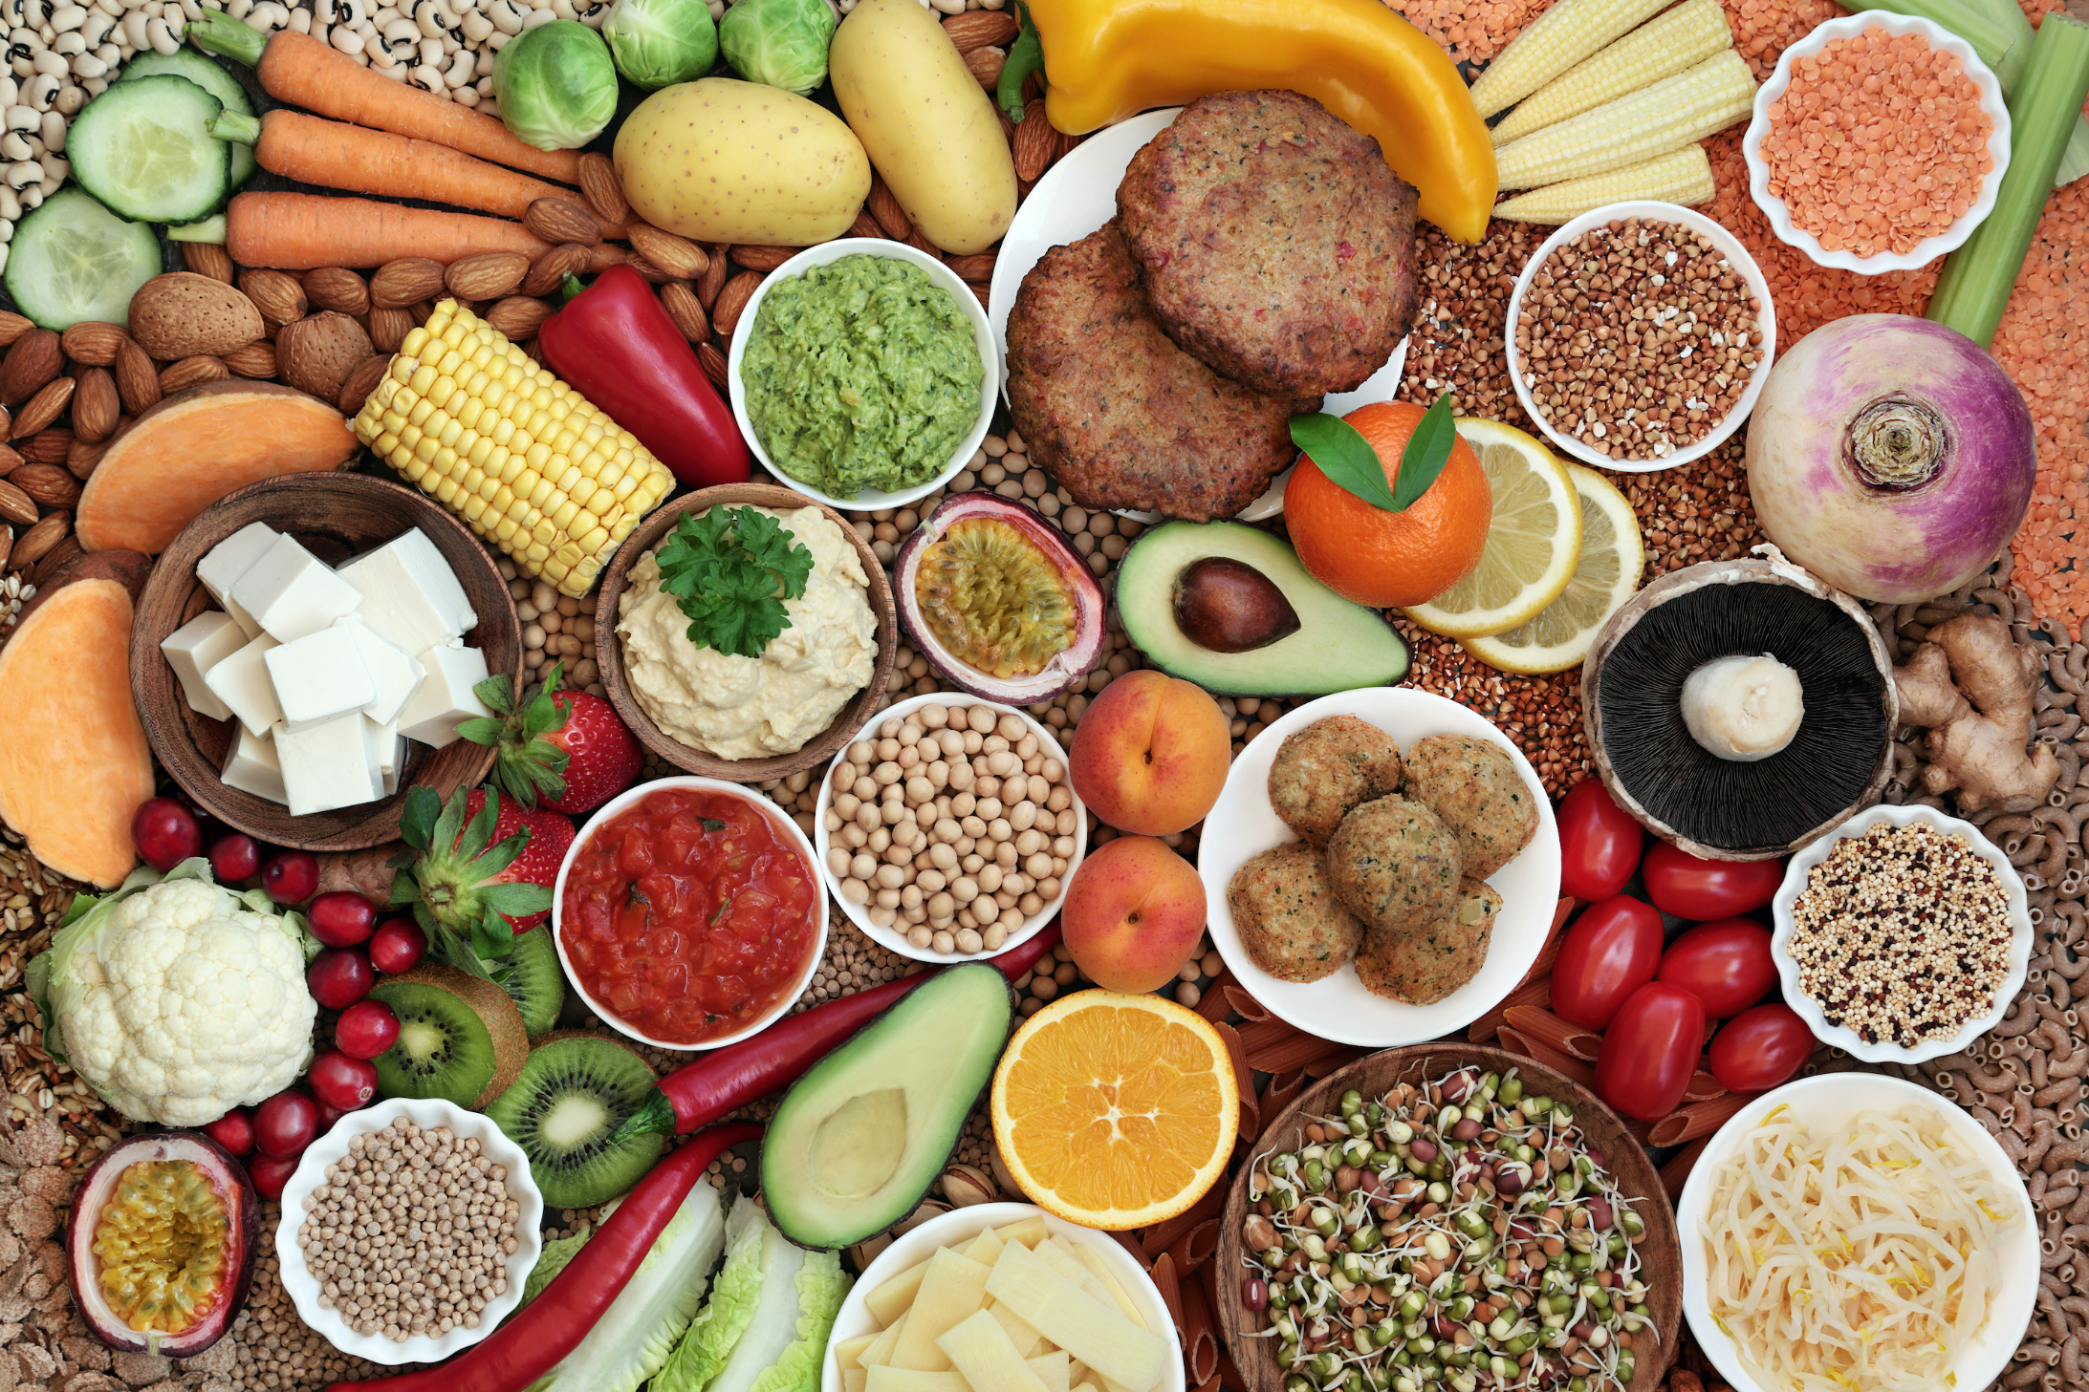
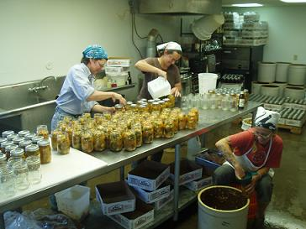
There is an amazing opportunity to Increase Investment
4. How Investment in Food can Help
Global Factors
(i.e., Climate Change, COVID, War, Energy Crisis, etc.) have raised awareness of the risks of the long- distance food system.
Dominik Barton (Standing Committee of Ag and Food 2021) and many others have reported on the need for increased investment in food processing in Canada.
Many individuals (most often women and members of equity deserving groups) are creating wonderful food products but are unable to commercialize them successfully and lack access to capital​
Notes:
CANDICE
Maximizing shareholder value is driving the food ecosystem towards massive consolidation:
Reducing cost through economies of scale and offshoring
Reducing competition to better control pricing and margins
Increase scale increases negotiation power with larger consolidated retailers
These conglomerates control the food industry and hinder the success of new ventures.
Government regulations (heavily influenced by corporate)
Councils and boards are heavily represented by international businesses
There is a call for a code of conduct for the large retailers who are increasing costs and increasing profits at the expense of processors and consumers
Government requirements need certifications used by Large companies which are expensive and prohibitive for smaller players
Marketing to consumers is becoming more challenging shifting the brand power from manufacturers to retailers (creating a power imbalance)
White label products are further exacerbating these issues
Global supply chains have high carbon costs and are vulnerable to global situations (pandemics, conflicts, etc.) reducing food sovereignty in Canada driving up food costs and increasing food scarcity, particularly for the more vulnerable.

Slide 37
The pipeline is there and resources are in place
4. How Investment in Food can Help
Over 90% of the 10,252 Food Processors in Canada are ‘small’.*
This doesn’t include hundreds of start-ups we know about across Canada
Trends and Drivers
1
2
3
Demand for Healthy and Sustainable Products
Consumers Want Locally Made Goods
Calls to “Reshore”, Making Local Economies More Sustainable
*Reported by Stats Canada as of 2021
Notes:
SANDY
Stats Can reported 10,252 F&B companies in 2021 with 26.4% of them as ‘micro’ and 63.6 % as ‘small’.
There is an increased market demand for healthy and sustainable products
Consumers continue to seek out and purchase locally made goods
There are calls internationally, nationally and locally for the food system to 'reshore', substantially transition to become resilient and sustainable, ‘closer to home’

Slide 38
So, what do we need to get there?
4. How Investment in Food can Help
✓
  Develop regional infrastructure to aggregate manufacturing for multiple processors
  Build a national coalition of support organizations to help small food processors
  Develop specialized programming for food processing entrepreneurs to get them INVESTMENT READY
  Influence agriculture policy to address the needs small food processors
  Access to aligned and impactful growth capital!
✓
✓
✓
û
*Reported by Stats Canada as of 2021

Slide 39
The Food System in Canada Needs Financing
4. How Investment in Food can Help
Lack of Support and Growth Capital
Many food processors fail in trying to meet increased demand due to lack of support and capital to grow beyond a local market
Lack of Regional Infrastructure to Support Domestic Food Processing
Over 50% of the agriculture production in Canada is exported*
There is limited / nonexistent regional manufacturing infrastructure to support small scale food processors
Investors don’t understand the Food Ecosystem.
Food businesses lack the scale of typical tech start ups
The food industry is complicated making it difficult for investors to evaluate risk and opportunity
The majority of food processors in Canada are female lead and face additional challenges in raising capital
* Innovation, Science and Economic Development Canada – Report of Canada’s Economic Strategy Tables
** based on SSFPA membership and anecdotal experience
Notes:
Scaling food processing businesses don’t align with traditional sources of capital:
Don’t meet the scale needs of Venture Capital
Don’t have the security needed for traditional commercial debt
Food businesses are predominantly lead by equity deserving groups who face additional barriers in accessing capital
Investors (including both traditional financial institutions and private equity / angel investors) don’t have the tools and background to evaluate and assess food businesses to understand the investment risk and opportunities so often overlook them as potential investments.

Slide 40
Women Face Negative Funding Experiences
4. How Investment in Food can Help
In a recent survey of SSFPA members, 100% of women indicated they faced some or all of the following issues when seeking funding for their new or growing business:
Turned away from their "regular" banks
  Need strong track record and prove profitability
  Need to own home or personally guarantee loans
  Gender barriers are clearly evident in investment process
Often forced to seek "B" lending
  high interest rates
  steep and unrealistic repayment plans
  Untrustworthy and unclear method to vet investors
Despite interest in creating equitable access to capital,
major lenders continue to use colonized approaches.
40

Slide 41
Financial Systems are not Equitable or Accessible
4. How Investment in Food can Help
Women led businesses only get 3% of venture capital invested in the food sector
Traditional investment processes rely heavily on ratios, credit history, and available security when assessing opportunities
The due diligence process is biased leading to different questions being asked to women, newcomers and others who don’t fit the typical entrepreneur profile.
Traditional private equity prioritizes early exits over growth and sustainability.
A new approach to financing SSFPs is critical to support food
sovereignty and increase the domestic value chain in food production.
Notes:
Scaling food processing businesses don’t align with traditional sources of capital:
Don’t meet the scale needs of Venture Capital
Don’t have the security needed for traditional commercial debt
Food businesses are predominantly lead by equity deserving groups who face additional barriers in accessing capital
Investors (including both traditional financial institutions and private equity / angel investors) don’t have the tools and background to evaluate and assess food businesses to understand the investment risk and opportunities so often overlook them as potential investments.

Slide 42
Next steps to enable investing in food
4. How Investment in Food can Help
            Create a showcase of food businesses who are seeking capital
1
  Develop case studies and success stories to demonstrate
  the viability of building out food infrastructure
2
            Design and launch new investment funds to be the intermediary between investors interested in making a different and food businesses actually doing it. ​
3
Venture-Capital Ready Program

Slide 43
There has never been a better time to think about Food
Summary
Canada is building momentum to regain our food sovereignty
Greater control over our food systems will strengthen local economies, increase food security, and improve the lives of Canadians.
Looking at new approaches to investing (outside of public markets, venture capital funds, or philanthropy) is critical to grow value, not just returns
Recognizing and breaking down systemic biases in investing is essential to support all food entrepreneurs
Venture-Capital Ready Program
43

Slide 44


Thank You
Kevin Taylor, Associate Director
kevin.taylor@svx.ca

